Slide 1

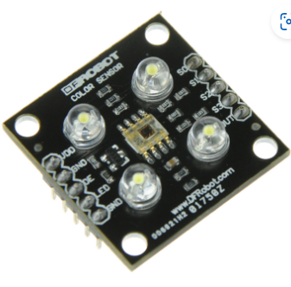
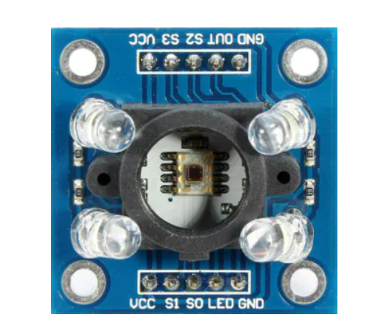
COLOR SENSOR
Hanqi zhao

Slide 2
Fundamentals of the assigned sensors are covered
Tricolor principle
various colors are mixed by three primary colors of different proportions (red, green and blue). Each color has a standard value. According to the above three primary color sensing principle, the value of a specific color is a linear combination of the standard values of red, green and blue colors.

Slide 3
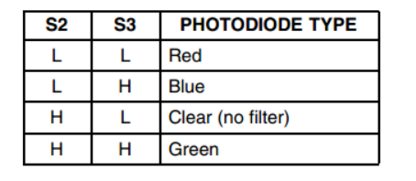
Fundamentals of the assigned sensors are covered
For the TCS3200, when a color filter is selected, it only allows a specific primary color to pass through, preventing other primary colors from passing through. The TCS3200 sensor has four types of filters: red, green, blue and clear. The filter mode can be selected by the high and low levels of its pins S2 and S3, as shown in the following figure.

Slide 4

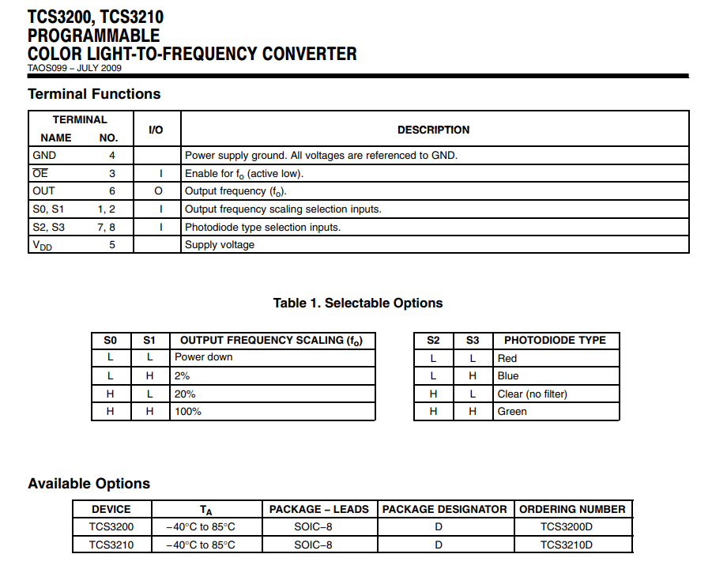
TABLE

Slide 5
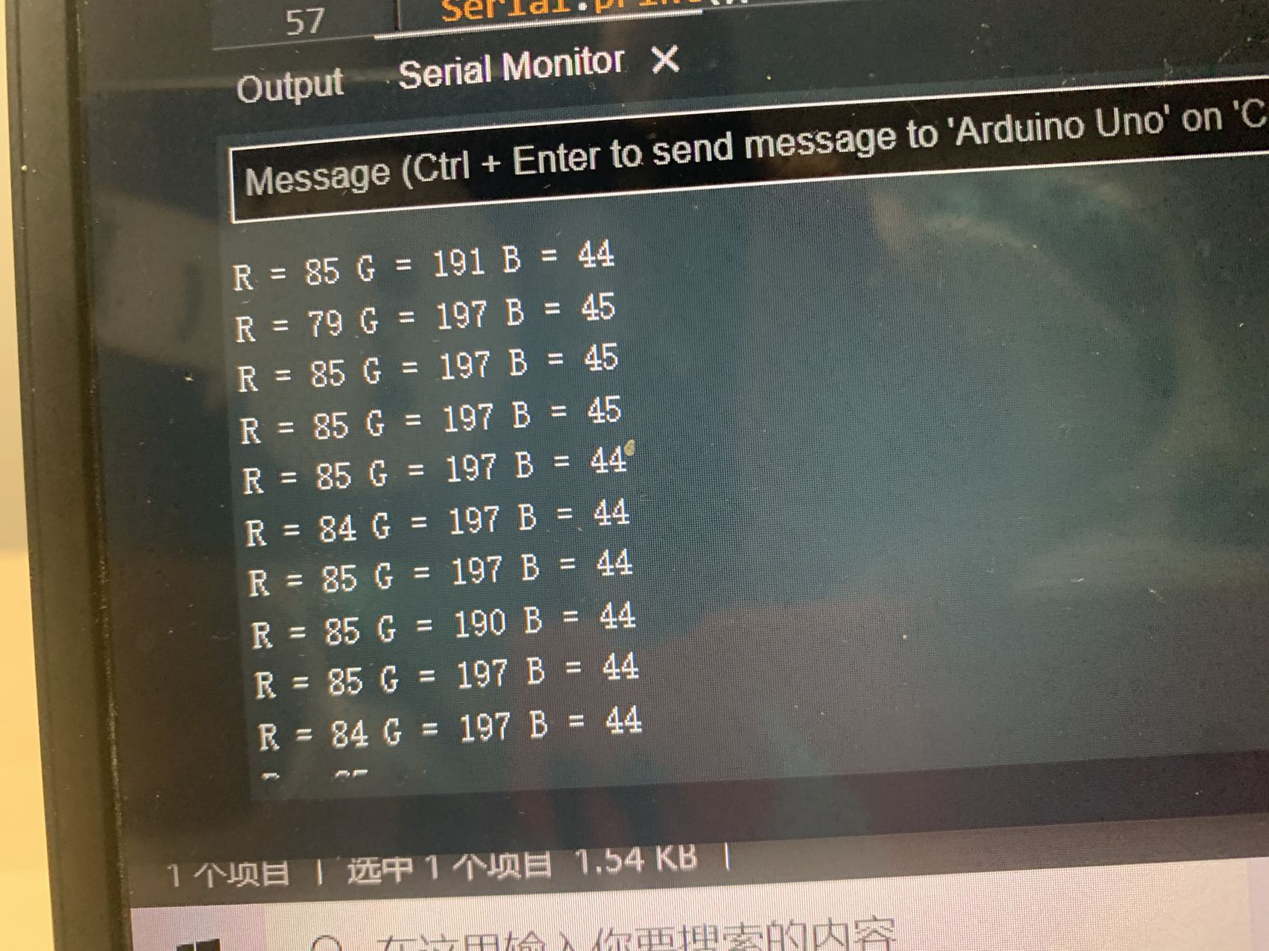
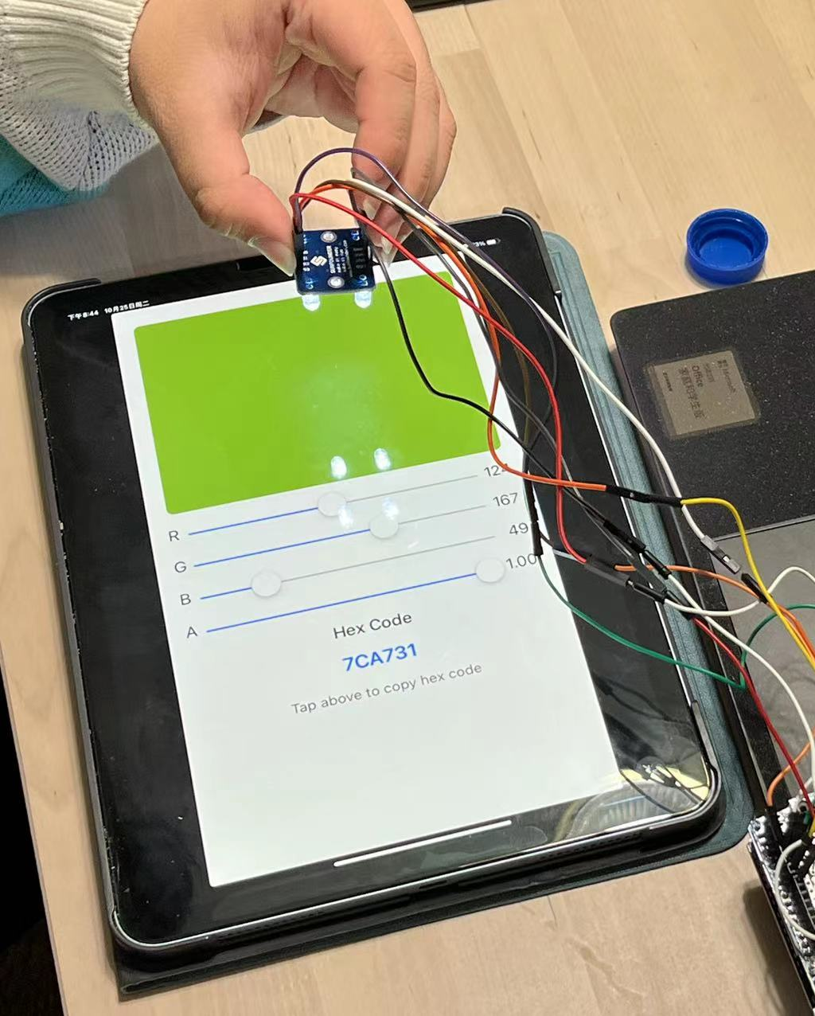
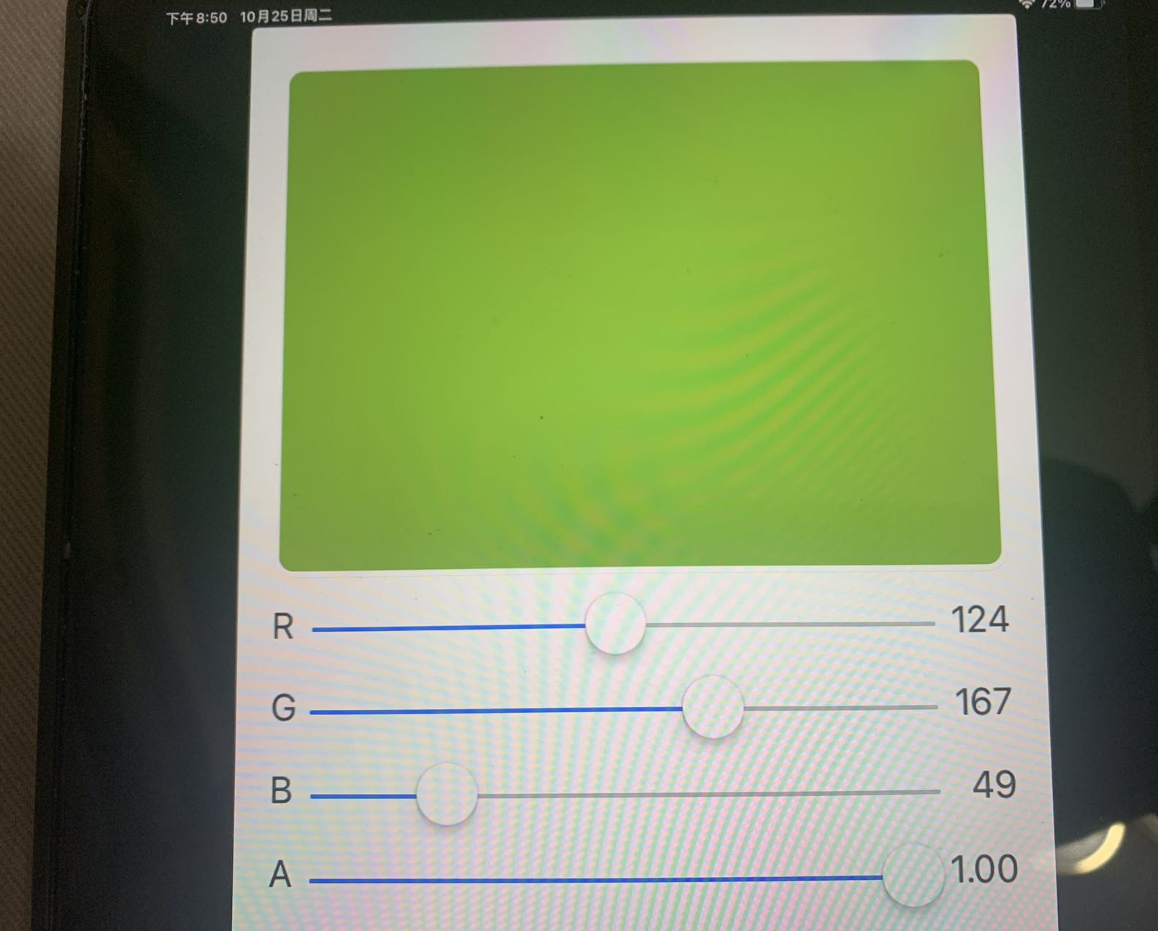
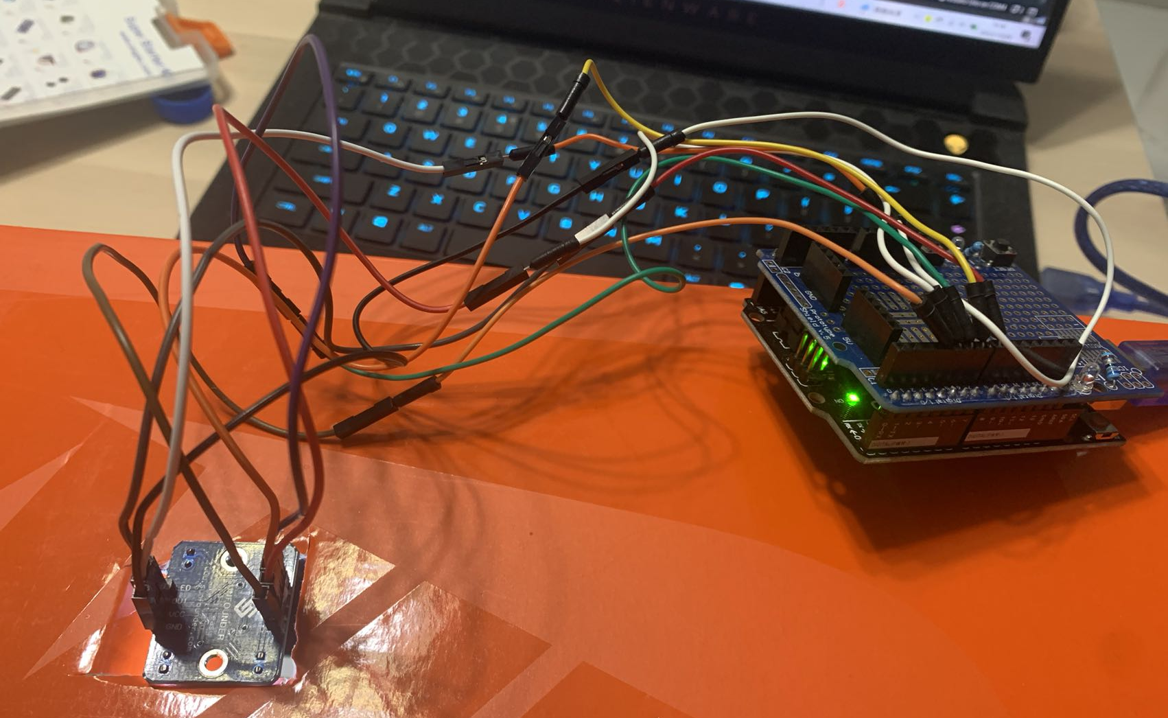
Test plan
Equipment: Ipad，TCS3200 color sensor , a shoe box, a loptop

Slide 6
Analysis of static characteristics
Range
Resolution
Error
Accuracy
Sensitivity
Linearity

Slide 7
Range
R :
27-215
G:
35-243
B:
5-92

Slide 8
resolution
R :
49
G:
32
B:
24

Slide 9
error
 | True value | Measured value | Error
R1 | 142 | 153 | 7%
G1 | 159 | 180 | 13%
B1 | 43 | 50 | 16%
R2 | 109 | 124 | 13%
G2 | 129 | 143 | 10%
B2 | 30 | 40 | 33%
R3 | 153 | 143 | 10%
G3 | 166 | 160 | 3%
B3 | 58 | 49 | 15%

Slide 10
Accuracy
According to the error test. I find that the accuracy is not very good.

Slide 11
CONCLUSION
THANK YOU

